Slide 1

Ethical Dilemmas in Germline Editing:
Focusing on Informed Consent
Second International Summit on Human Genome Editing
The University of Hong Kong
November 27-29, 2018
Judith Daar
Clinical Professor, UCI School of Medicine
Visiting Professor, UCI School of Law
Chair, ASRM Ethics Committee

Slide 2

“NIH will not fund any use of gene-editing technologies in human embryos…Advances in technology have given us an elegant new way of carrying out genome editing, but the strong arguments against engaging in this activity remain. These include the serious and unquantifiable safety issues, ethical issues presented by altering the germline in a way that affects the next generation without their consent, and a current lack of compelling medical applications justifying the use of CRISPR/Cas9 in embryos.”
Francis S. Collins, Director, National Institutes of Health
Statement on NIH funding of research using gene-editing technologies in human embryos, April 28, 2015.
Informed Consent and U.S. National Policy on Germline Genome Editing

Slide 3
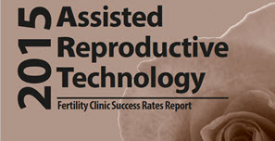
Sources of Consent for Research Using Gametes and Embryos
Patients undergoing IVF
  Autologous v. Donated Gametes
Gamete Donors
  Directed Donation to IPs
  Provision to Clinic or Gamete Bank
Fertility Clinics
  Abandoned gametes, embryos
  Unselected donor gametes, embryos
Guardian Ad Litem
  Appointed to represent potential child

Slide 4

Is There a Role for Guardian Ad Litem in Germline Research?
GAL common in probate and child welfare legal proceedings
Represented minor can be born or unborn
Standard is to act in the best interest of the child
Recent controversy over GAL appointment in embryo disputes
  Challenges notion that preimplantation embryos are not persons
  Could result in prohibition on embryo discard and cryopreservation
GAL could be instructed to balance risks and benefits of proposed research, taking donor preferences into account

Slide 5

Standards for Research Approval:
Is There a Role for Existing Models?
Federal regulations address research on pregnant women, fetuses, neonates in 45 CFR 46, Subpart B.
Risk to fetus must hold out direct benefit to pregnant woman or fetus; if no prospect of benefit, “risk to the fetus is not greater than minimal and the purpose of the research is the development of important biomedical knowledge which cannot be obtained by any other means…”
Research not otherwise approvable may move forward if further understanding of serious health problem affecting pregnant women, fetuses or neonates.

Slide 6
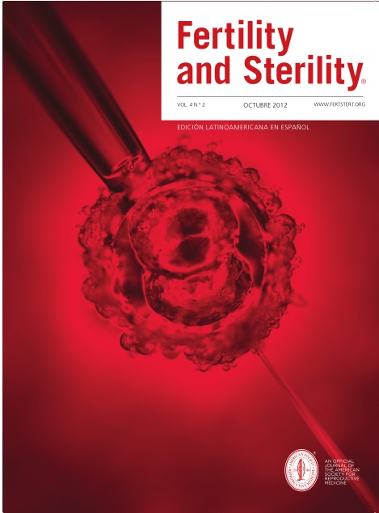
When Should Consent for Research Be Obtained?
“It is important that patients decide to donate embryo for research only after they have decided not to continue storing their embryos.”
“[E]mbryos created through the use of a third-party gamete donor should be used for hESC research only if if specific consent for such use was provided by the gamete donor in advance of the creation of the embryos.”
Donating Embryos for Human Embryonic Stem Cell Research, Ethics Committee, American Society for Reproductive Medicine (2013)

Slide 7

Timing of Consent for Using Embryos or Gametes in Research
Prior to Retrieval
IVF patients using their own gametes
Directed/known gamete donors
Donors supplying to banks w/o IPs
Research setting
Following Retrieval
IVF patients post-completion family or Tx
3rd party donors not previously queried
3rd party give broad consent for disposition
Previous consent outdated or limited

Slide 8


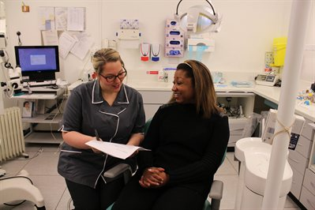
Perspectives on Contemporaneous Consent for Research
Should always be required?
In direct donation to research
By embryo donors after IVF completion
By all gamete providers via tracing
Should sometimes be required?
By gamete/embryo donors who did not previously give consent to research
Should never be required?
By gamete/embryo donors who assign full decisional authority to recipients

Slide 9

Judging the Substance:
Broad, Roll-Down or Specific Consent?
Broad Consent
General language granting consent to TBD research at some future point
Roll-Down Consent
  Presents subject with list of rule-out or rule-in options
Specific Consent
  Form must include project description, source of funding, policy on downstream disclosures, etc.

Slide 10
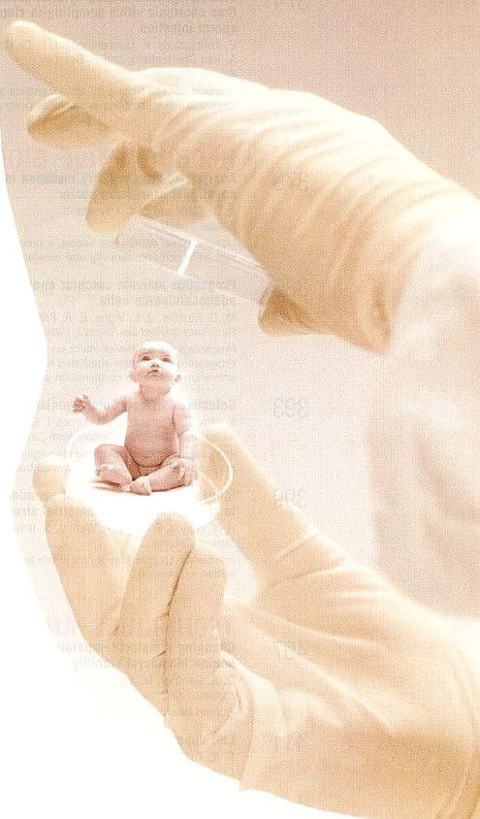
Final Thoughts…
Global aspects of germline gene editing will impact consent process in each jurisdiction, best to plan for inclusion
Researchers might consider intermediaries to secure informed consent to avoid (appearance of ) conflict of interest
Best practices account for change of mind, proxy decision-makers, risks of identification, impact on consanguineous relatives

Slide 11
Thanks So Much

